Slide 1
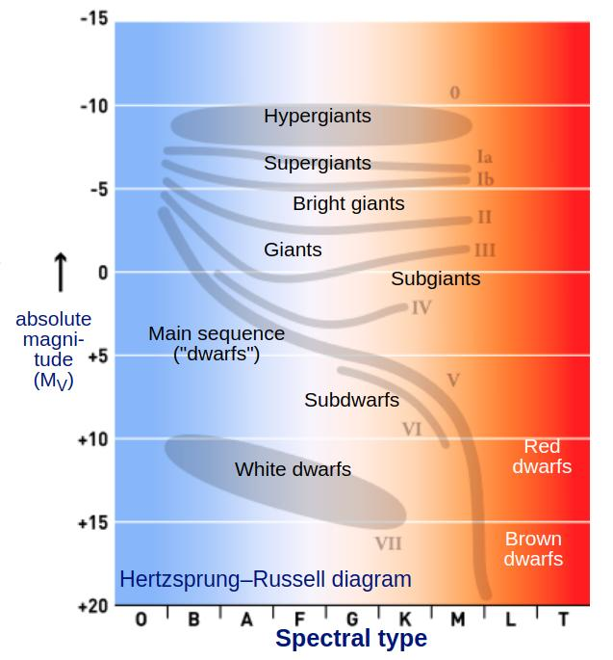
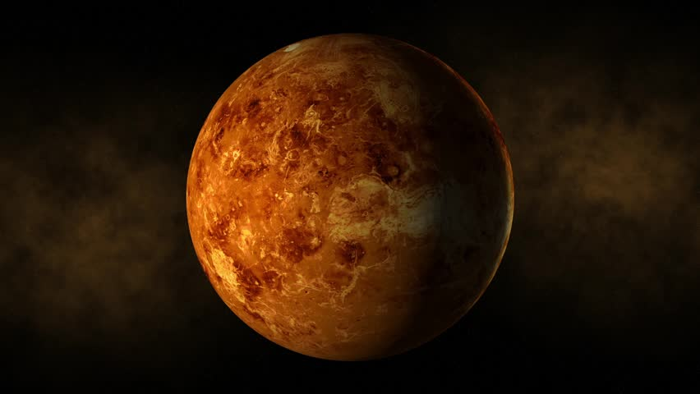
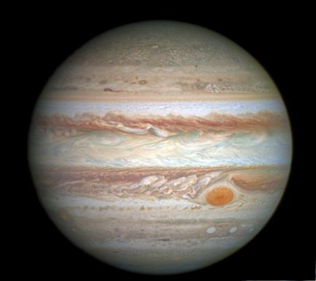
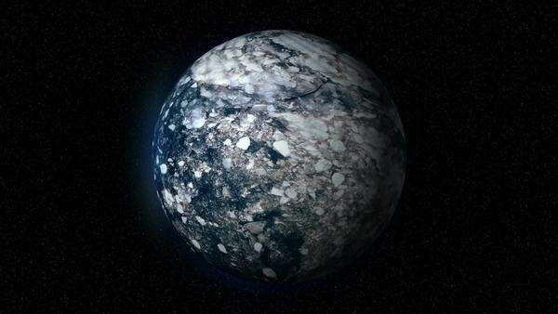
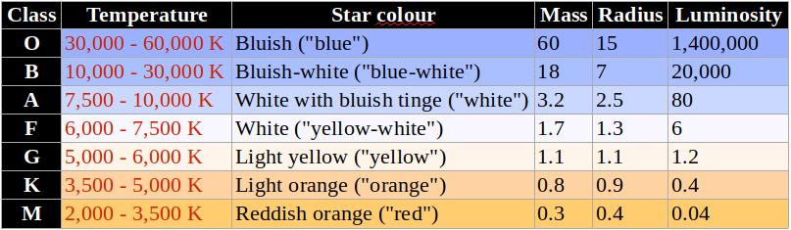
Stars
Planets
Habitable zone
Rocky planet
Gas planet
Ice planet
Notes:
Sources: https://en.wikipedia.org/wiki/Stellar_classification#Class_A
https://space.fandom.com/wiki/Stellar_classification
https://www.shutterstock.com/video/clip-3217180-planet-venus-space-stars
http://spiff.rit.edu/classes/phys106/lectures/gas_giants/gas_giants.html
https://dissolve.com/video/fictional-ice-planet-space-Ice-chunks-move-planet-slowly-royalty-free-stock-video-footage/001-D652-131-009
https://planetary-science.org/astrobiology/habitable-zones/

Slide 2
Player: -spaceship from a super advanced civilization
Purpose: -helps a new solar system to form
Gameplay: -capture and slingshot asteroids
Score: -maximize the potential survivors by having as many planets as possible in Goldilocks zone

